Slide 1
Genetic algorithms
Travelling salesman problem

Slide 2
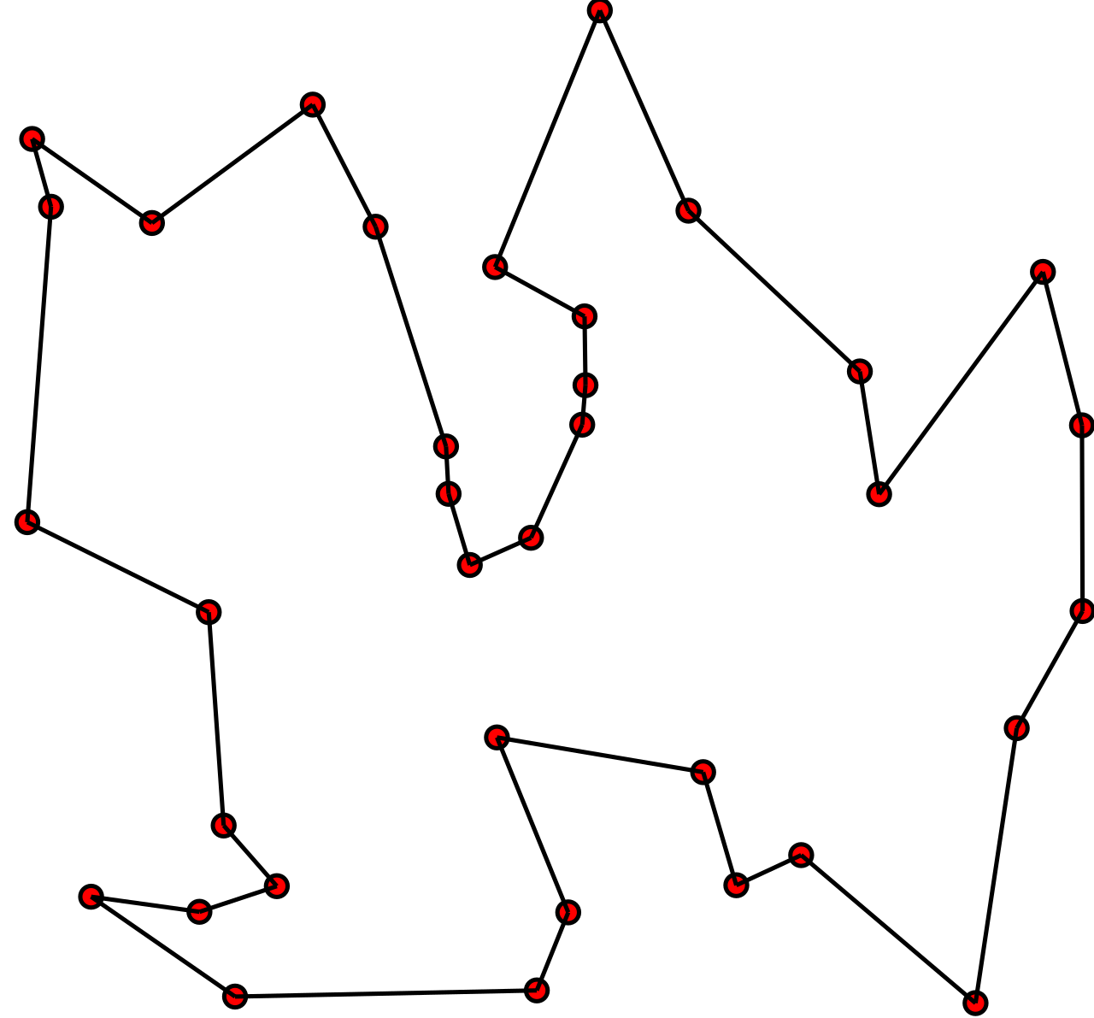
The idea of the problem

Slide 3
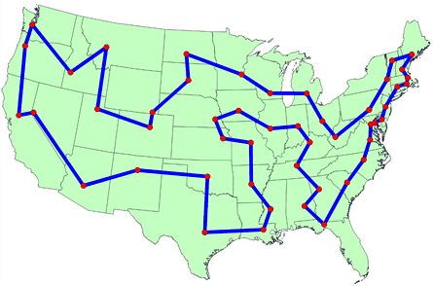
The idea of the problem

Slide 4

What is complexity of brute force approach?

Slide 5
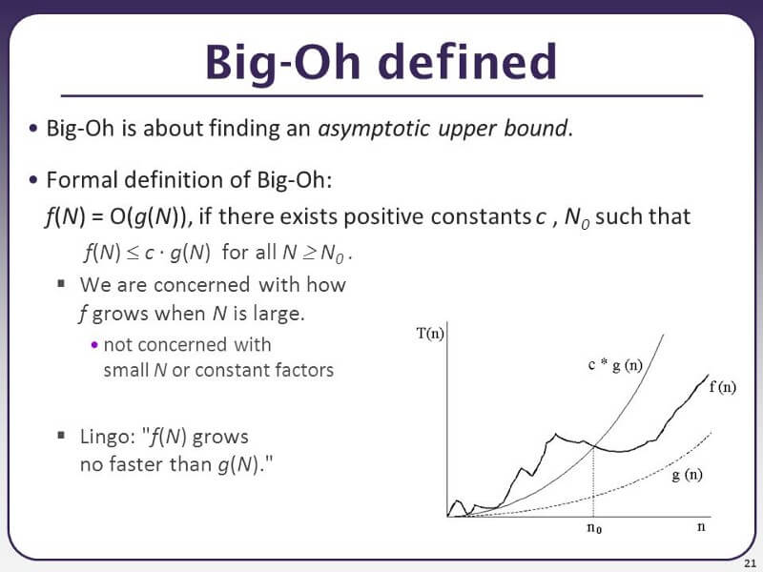
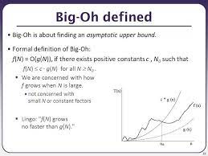

Slide 6
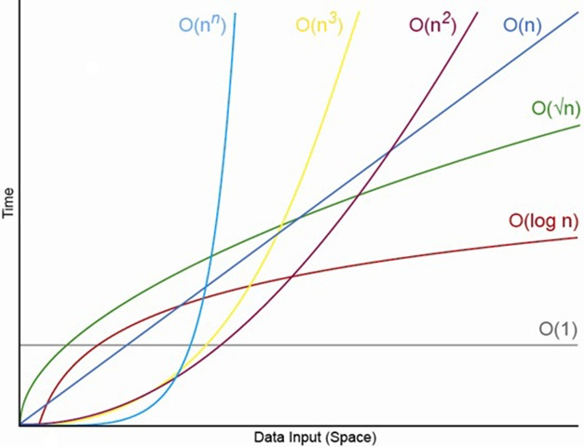
Big O notation

Slide 7
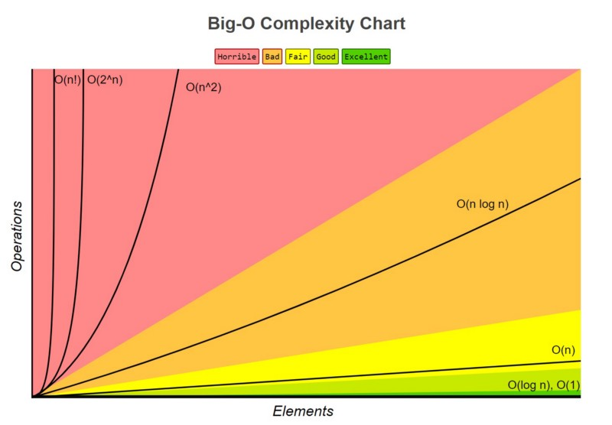
Big O notation

Slide 8
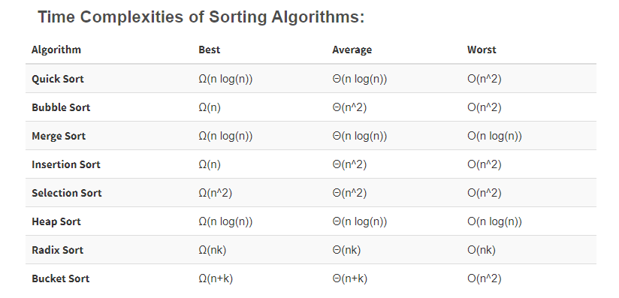
Sorting algorithms
https://www.youtube.com/watch?v=kPRA0W1kECg

Slide 9
What is complexity of brute force approach?

Slide 10
What is complexity of brute force approach?
O(n!)

Slide 11
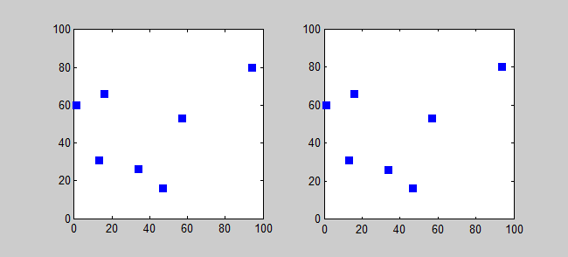

Slide 12
History of the problem
In an 1832 manual for traveling salesman, which included example tours of 45 German cities but gave no mathematical consideration.
W. R. Hamilton and Thomas Kirkman devised mathematical formulations of the problem in the 1800s. It is believed that the general form was first studied by Karl Menger in Vienna and Harvard in the 1930s.
Hassler Whitney, who was working on his Ph.D. research at Harvard when Menger was a visiting lecturer, is believed to have posed the problem of finding the shortest route between the 48 states of the United States during either his 1931-1932 or 1934 seminar talks.
The problem became increasingly popular in the 1950s and 1960s. Notably, George Dantzig, Delber R. Fulkerson, and Selmer M. Johnson at the RAND Corporation in Santa Monica, California solved the 48 state problem by formulating it as a linear programming problem.
In the early 1970s, the concept of P vs. NP problems created buzz in the theoretical computer science community. In 1972, Richard Karp demonstrated that the Hamiltonian cycle problem was NP-complete, implying that the traveling salesman problem was NP-hard.
Increasingly sophisticated codes led to rapid increases in the sizes of the traveling salesman problems solved. Dantzig, Fulkerson, and Johnson had solved a 48 city instance of the problem in 1954.
Martin Grötechel more than doubled this 23 years later, solving a 120 city instance in 1977.
Enoch Crowder and Manfred W. Padberg again more than doubled this in just 3 years, with a 318 city solution.
In 1987, rapid improvements were made, culminating in a 2,392 city solution by Padberg and Giovanni Rinaldi. In the following two decades, David L. Appelgate, Robert E. Bixby, Vasek Chvátal, & William J. Cook led the cutting edge, solving a 7,397 city instance in 1994 up to the current largest solved problem of 24,978 cities in 2004.

Slide 13
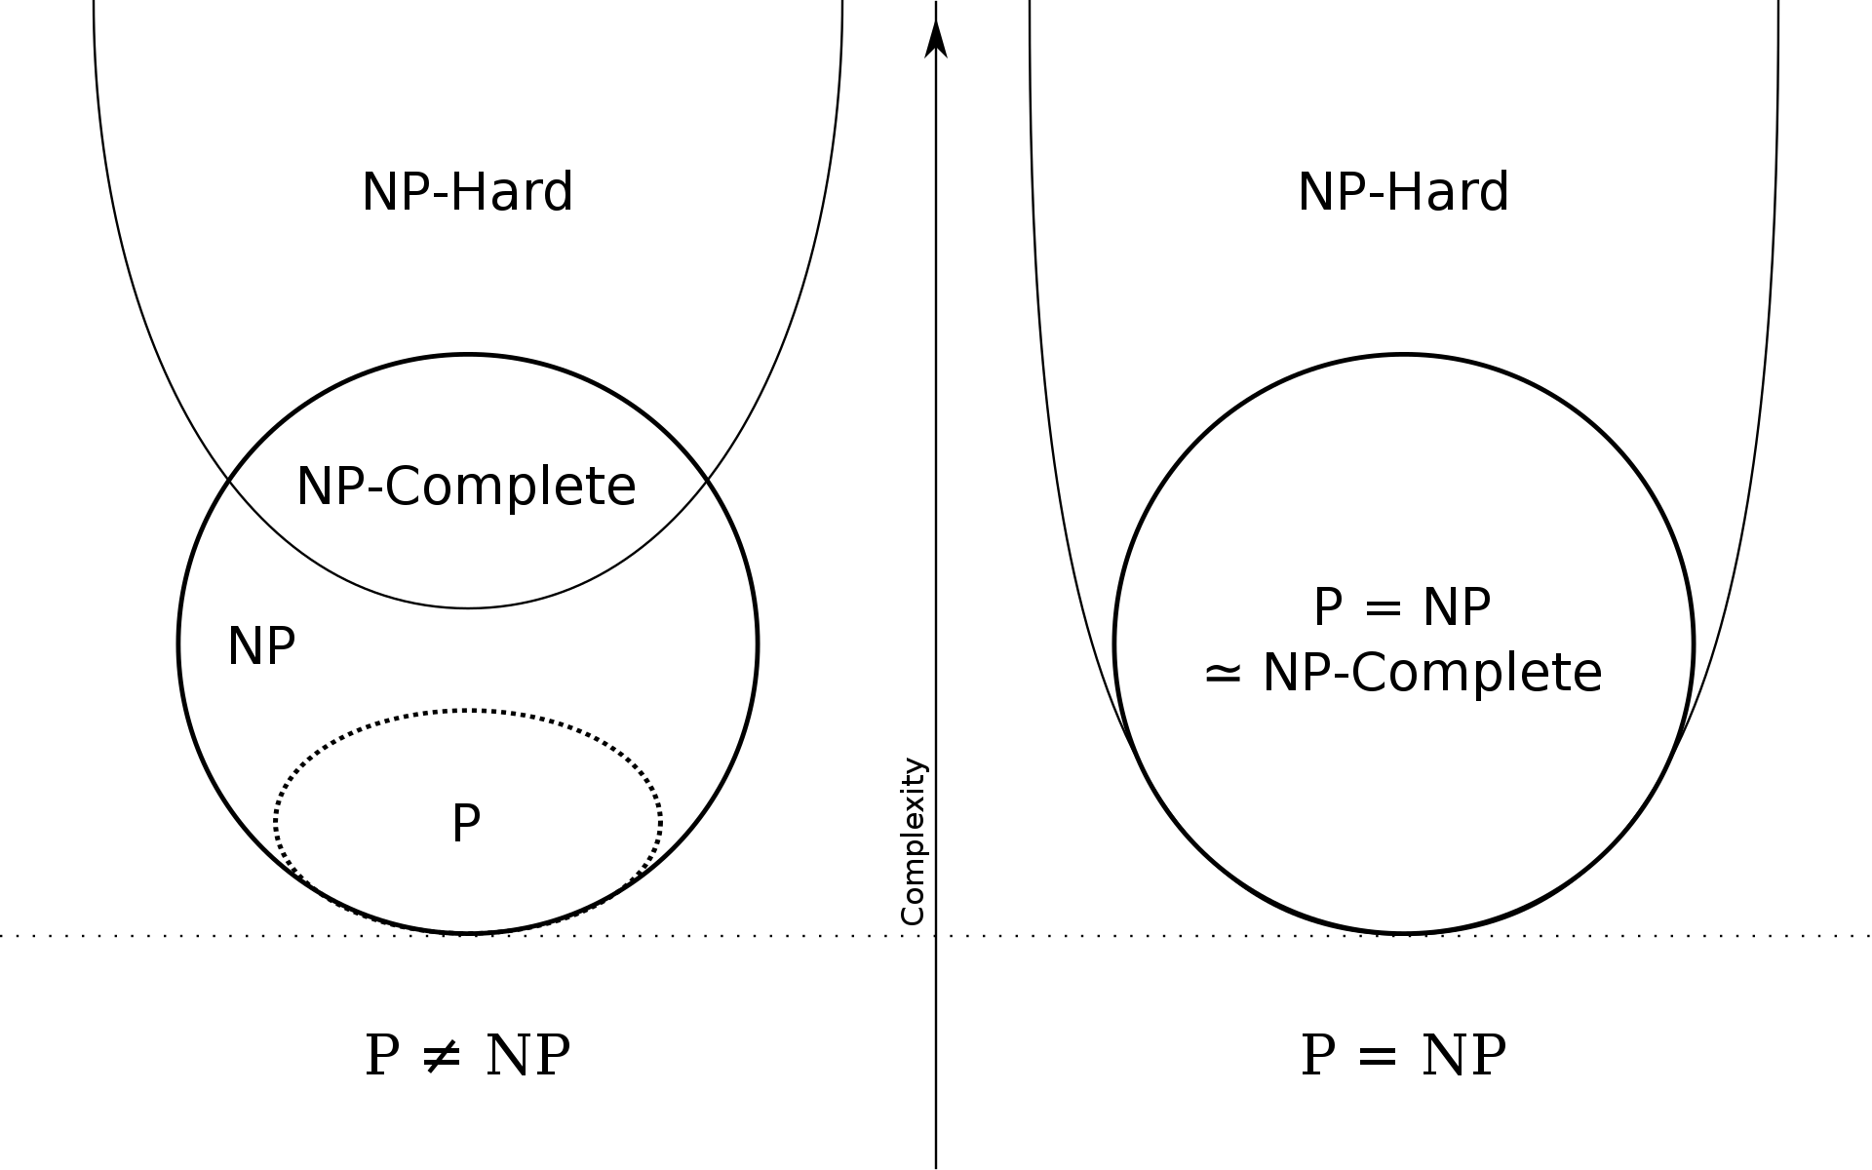
P VS NP

Slide 14
Greedy algorithms

Slide 15
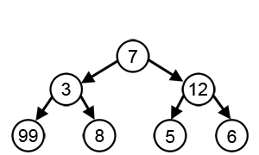
Greedy algorithms

Slide 16
What can be greedy algorithm in TSP?

Slide 17
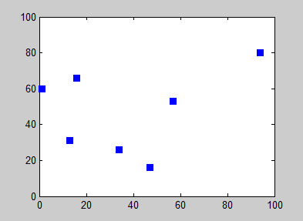
What can be greedy algorithm in TSP?

Slide 18
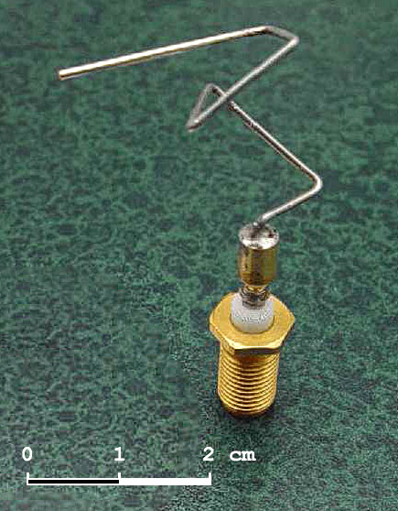
Genetic algorithms
The 2006 NASA ST5 spacecraft antenna. This complicated shape was found by an evolutionary computer design program to create the best radiation pattern.

Slide 19
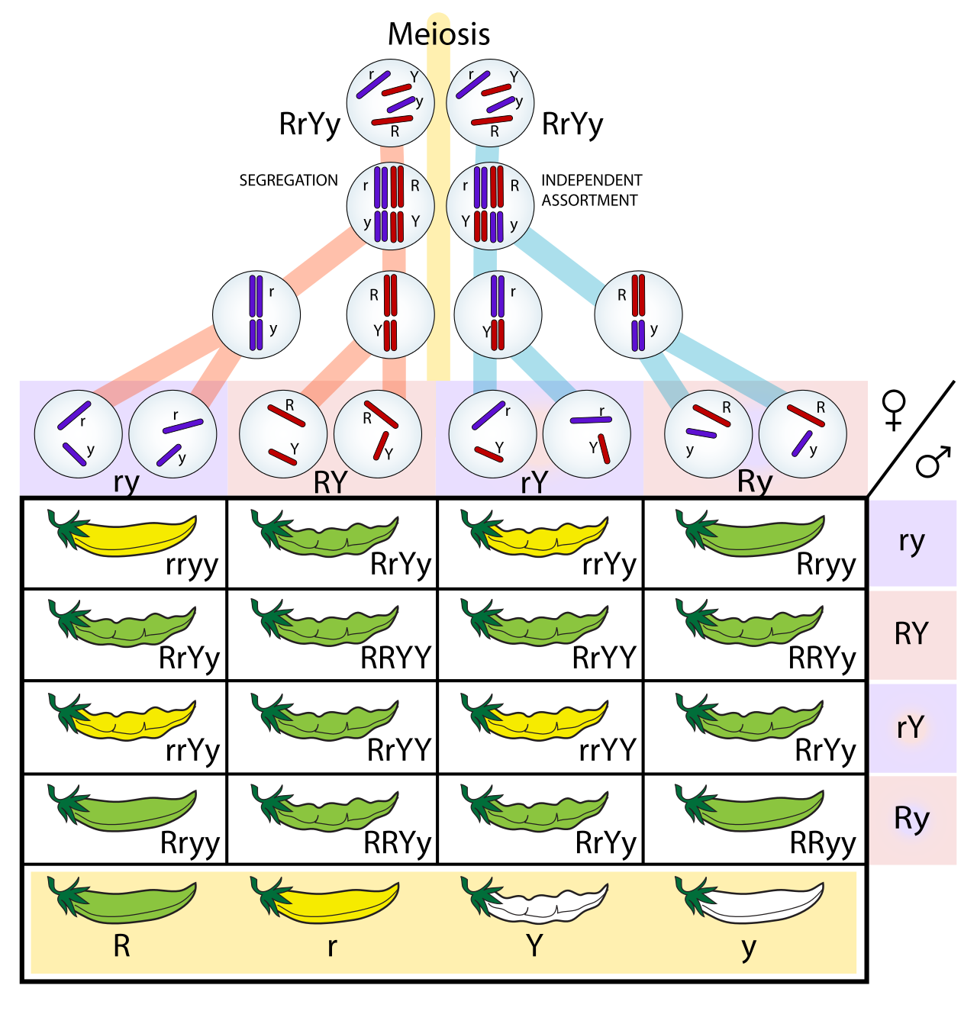
Genetic algorithms

Slide 20
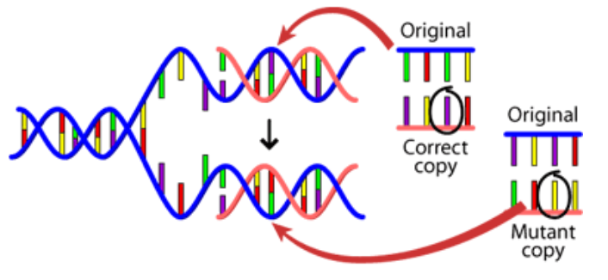
Genetic algorithms

Slide 21
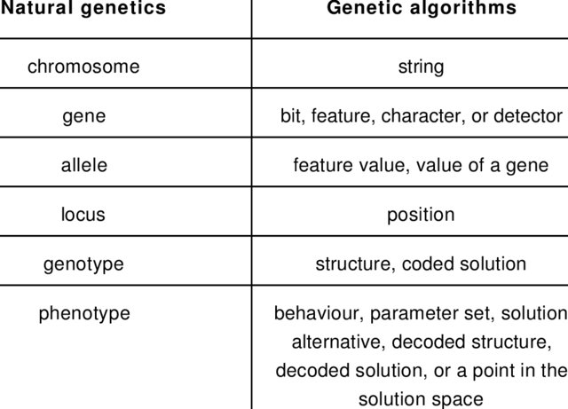
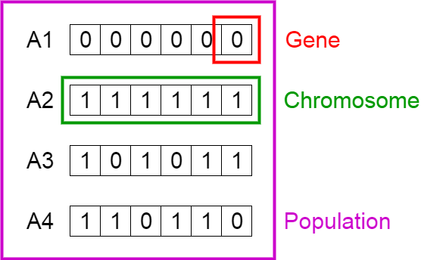
Genetic algorithms

Slide 22
Phases of genetic algorithms
Initial population
Fitness function
Selection
Crossover
Mutation

Slide 23
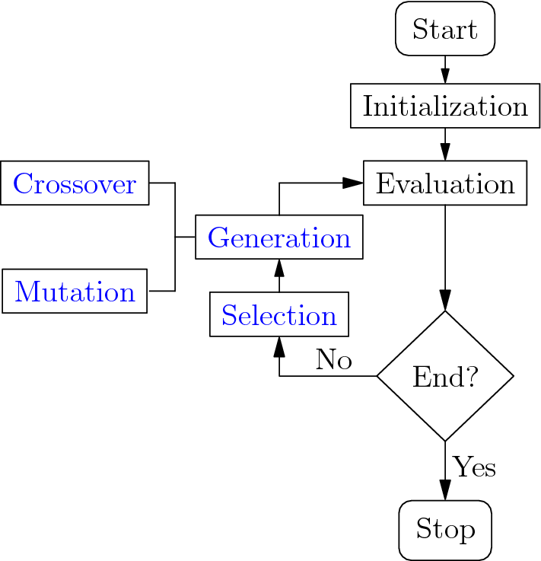

Slide 24
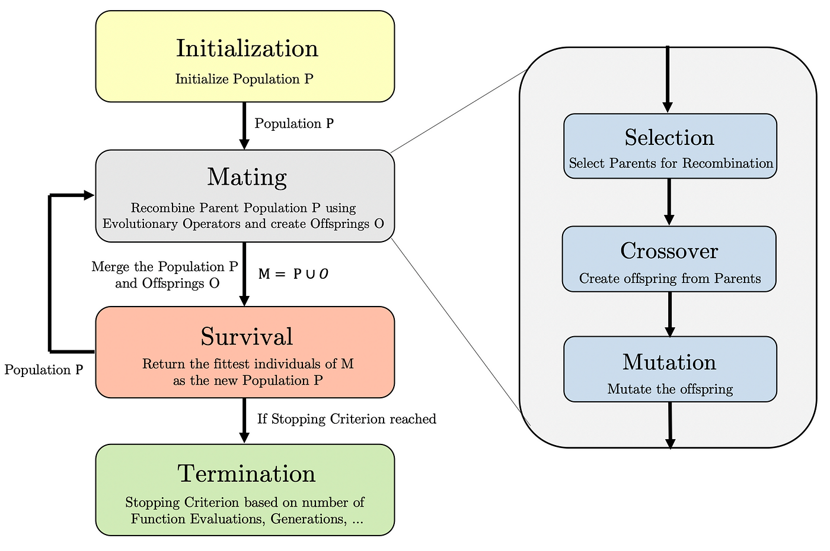

Slide 25
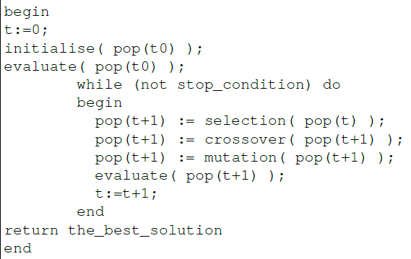
Pseudocode

Slide 26
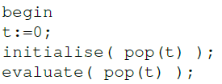
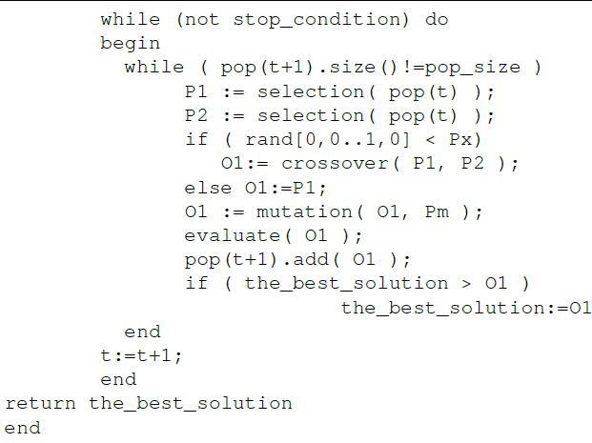
Pseudocode

Slide 27
Phases of genetic algorithms
Initial population
Fitness function
Selection
Crossover
Mutation

Slide 28
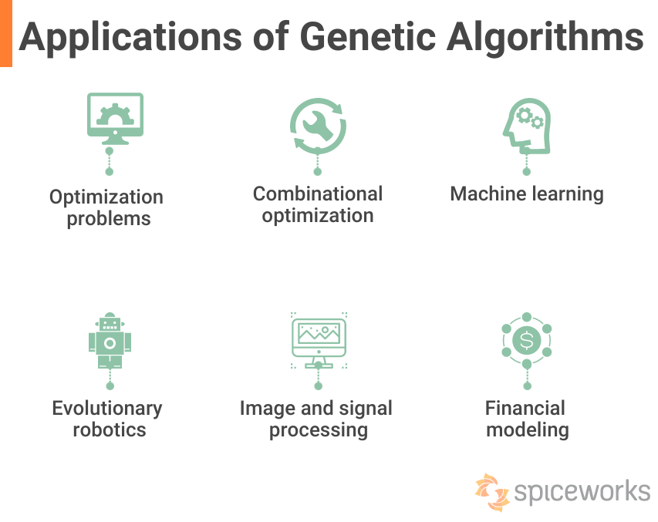

Slide 29
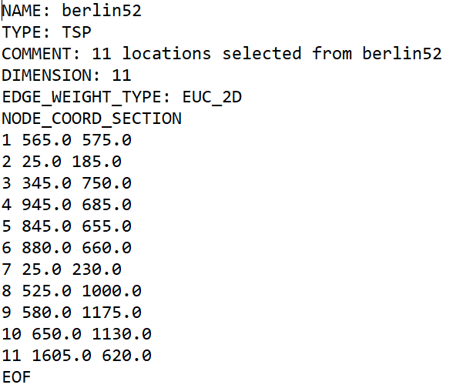
How to apply GA to real problem like TSP?

Slide 30
How to describe individual?

Slide 31
What is initial population?

Slide 32
Phases of genetic algorithms
Initial population
Fitness function
Selection
Crossover
Mutation

Slide 33
What is fitness function?

Slide 34
Phases of genetic algorithms
Initial population
Fitness function
Selection
Crossover
Mutation

Slide 35
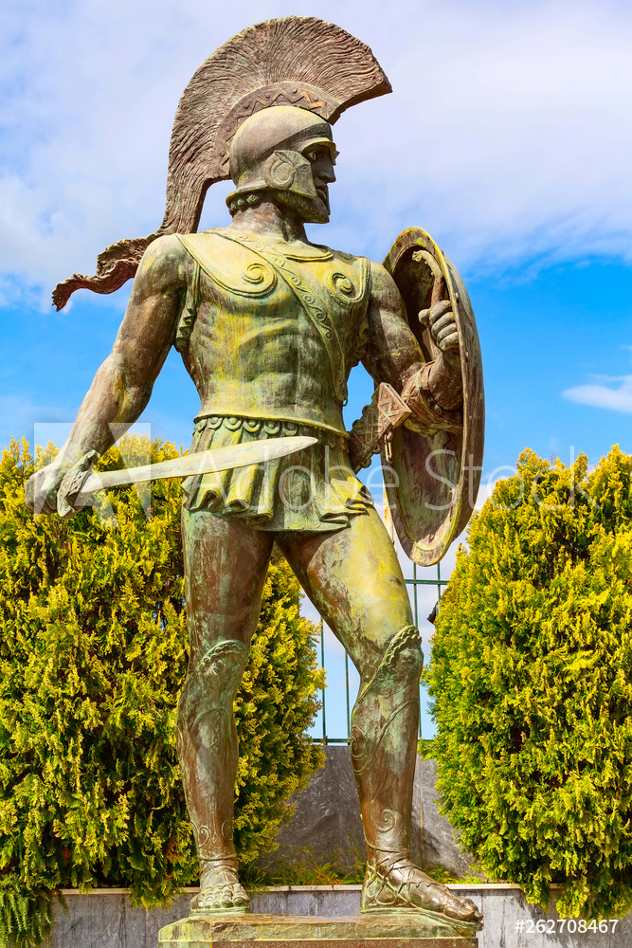
What is selection stage?

Slide 36
Selection stage
Tournamemt
Elite
Roullette

Slide 37
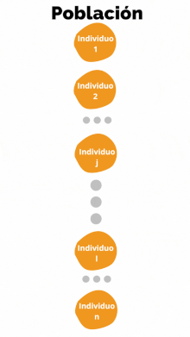
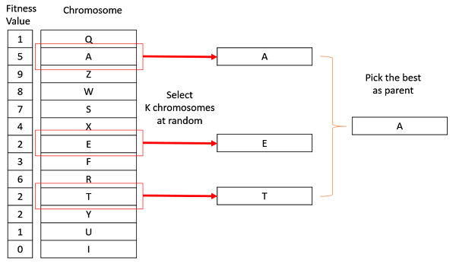
Tournament selectio (example)

Slide 38
Tournament selectio (example)
choose k (the tournament size) individuals from the population at random
choose the best individual from the tournament with probability p
choose the second best individual with probability p*(1-p)
choose the third best individual with probability p*((1-p)^2)
and so on

Slide 39
Elitist selection
Often to get better results, strategies with partial reproduction are used. One of them is elitism, in which a small portion of the best individuals from the last generation is carried over (without any changes) to the next one.

Slide 40
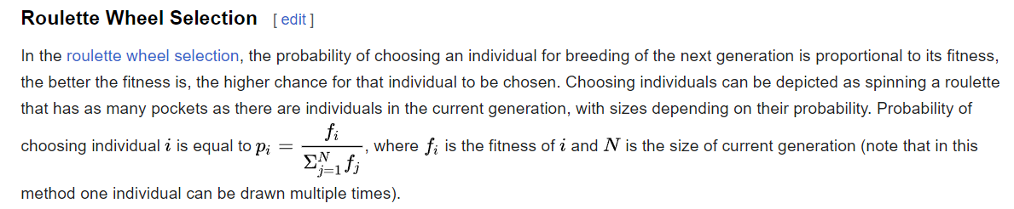
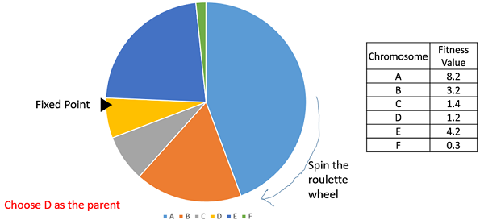
Roulette selection

Slide 41
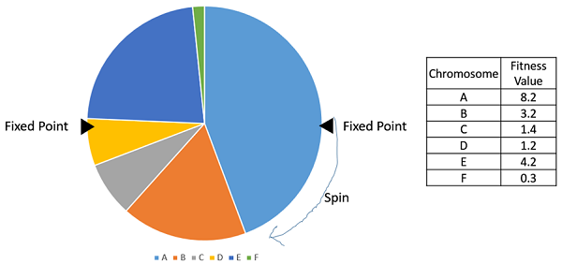
Stochastic Universal Sampling (SUS)

Slide 42
Phases of genetic algorithms
Initial population
Fitness function
Selection
Crossover
Mutation

Slide 43
What is crossover stage?

Slide 44
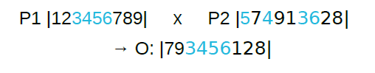
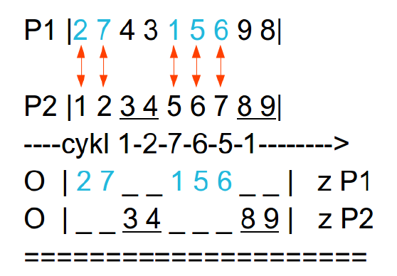
Crossovers method
Ordered crossover (OC)
Partially matched-crossover (PMX)
Cycle crossover (CX)
https://en.wikipedia.org/wiki/Crossover_(genetic_algorithm)

Slide 45
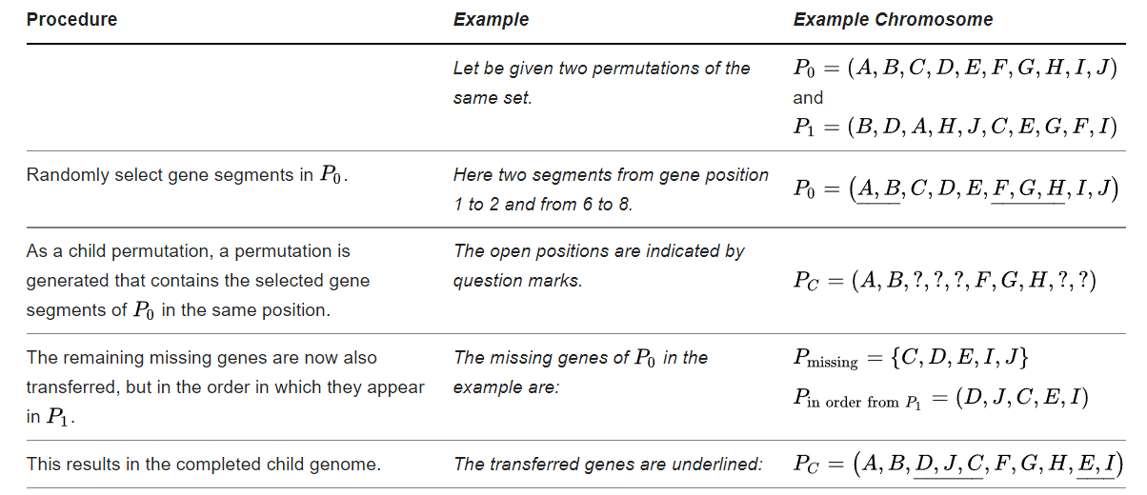
Ordered crossover

Slide 46
https://www.hindawi.com/journals/cin/2017/7430125/

Slide 47
Phases of genetic algorithms
Initial population
Fitness function
Selection
Crossover
Mutation

Slide 48
Why we need mutation?

Slide 49
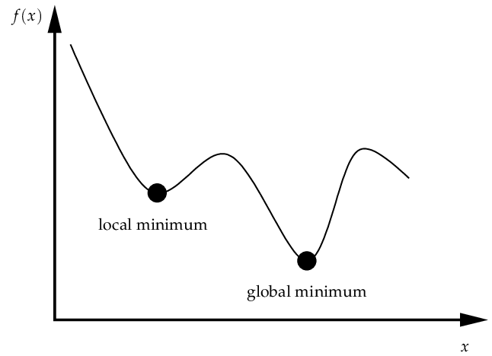
Why we need mutation?

Slide 50
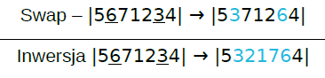
How we can apply mutation?

